Slide 1
HOW TO OPTIMIZE FOR FEATURED SNIPPETS
By Ann Smarty
@seosmarty
Brand & Community Manager at
Internet Marketing Ninjas

Slide 2
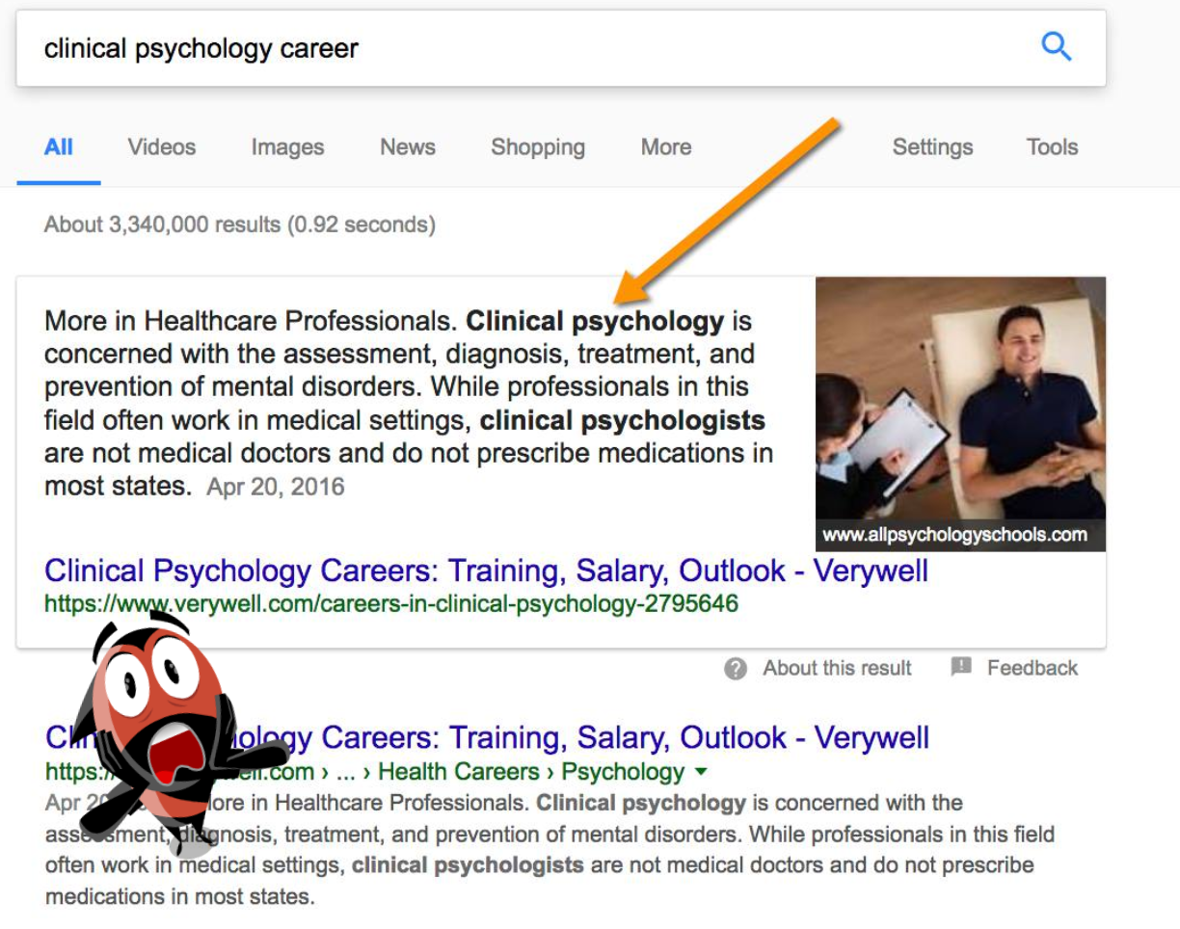
@seosmarty

Slide 3
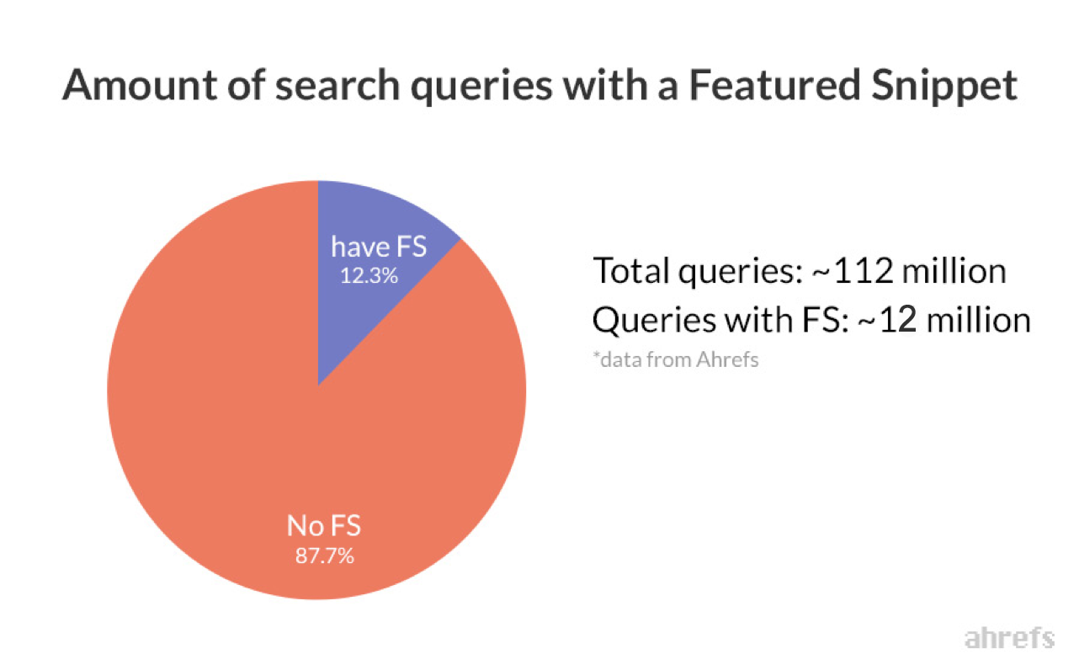
AHREFS study
@seosmarty

Slide 4
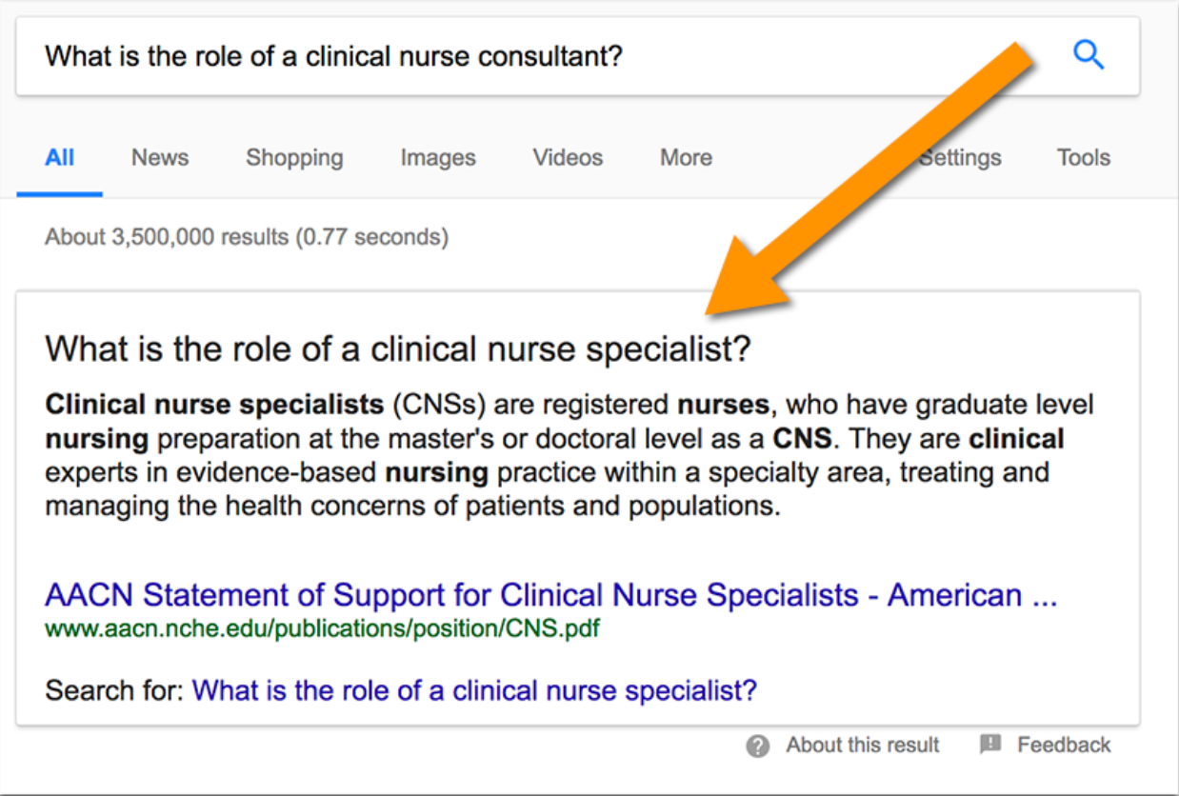
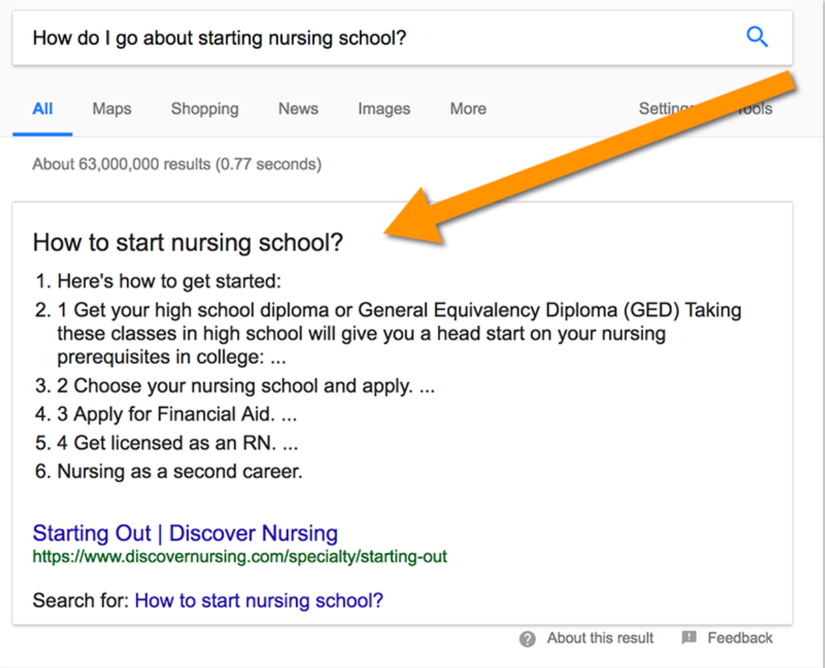
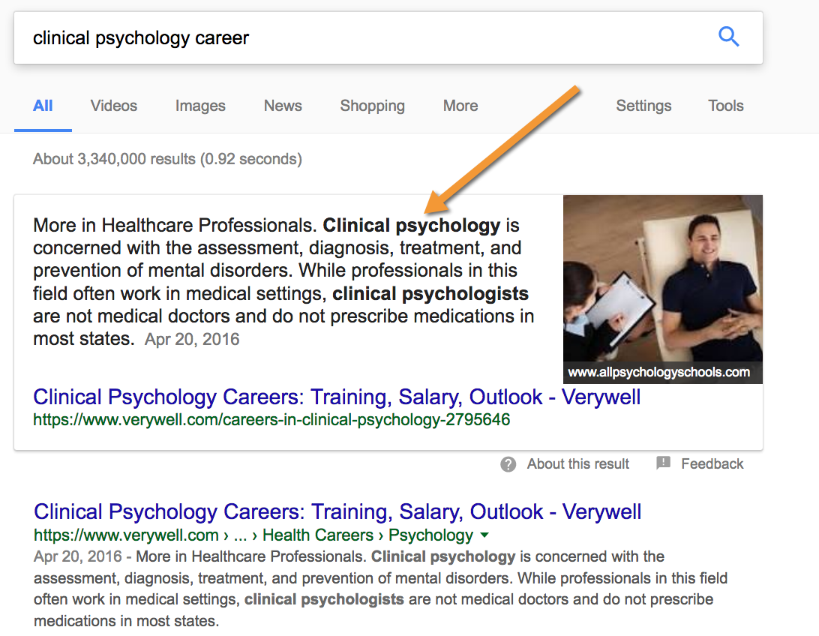
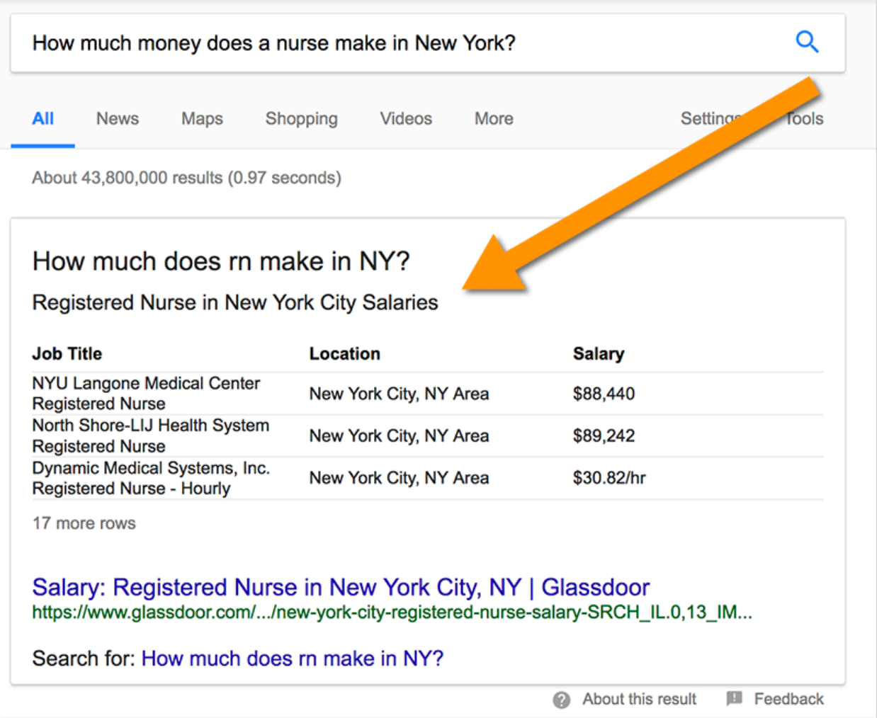
@seosmarty

Slide 5
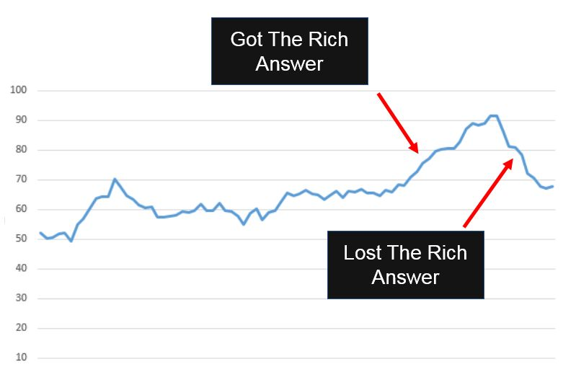
David Kutcher of Confluent Forms
@seosmarty

Slide 6
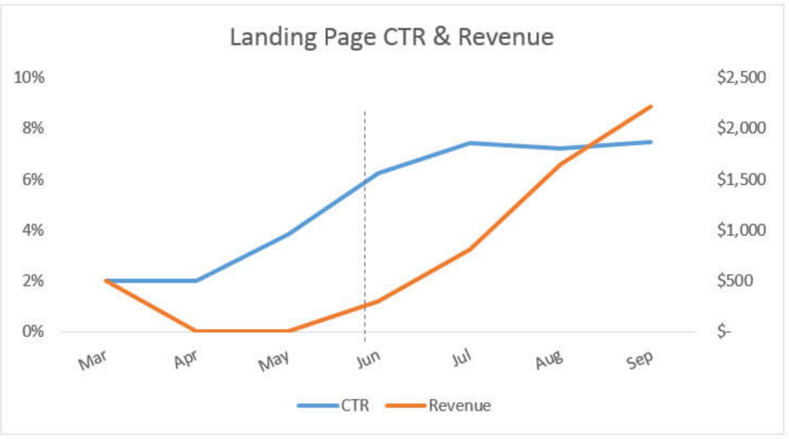
Ben Goodsell:
Traffic increased by 505%
CTR increased from 2% to 8%
Revenue increased by 677%
@seosmarty

Slide 7
Friend or Foe:
@seosmarty

Slide 8
Friend or Foe:
It’s either your page that’s being featured or your competitor’s
@seosmarty

Slide 9
HOW TO GET FEATURED?
@seosmarty

Slide 10
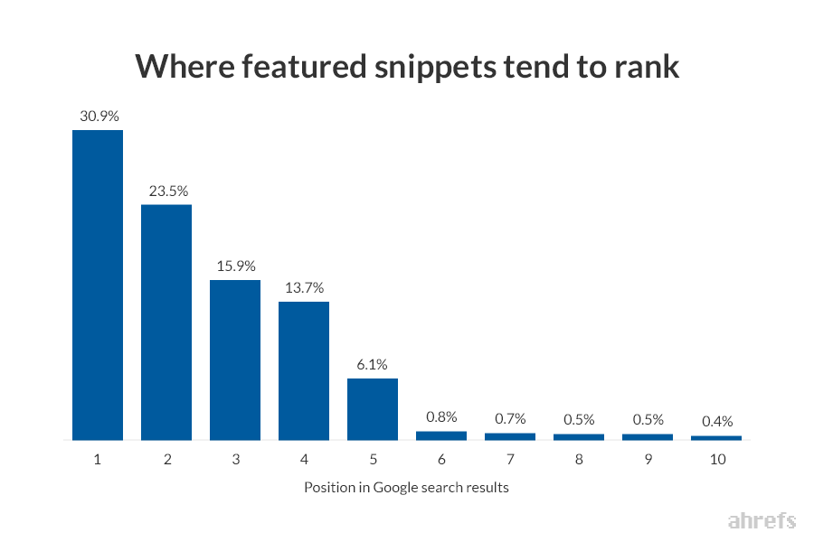
AHREFS study: 99% already rank in top 10
@seosmarty

Slide 11
AHREFS study: 30% rank #1
@seosmarty

Slide 12
Research those “long-tail” keywords where you rank or can rank in top 10
@seosmarty

Slide 13
…the more words are typed in a search box, the higher the probability there will be a featured snippet…
AHREFS study
@seosmarty

Slide 14
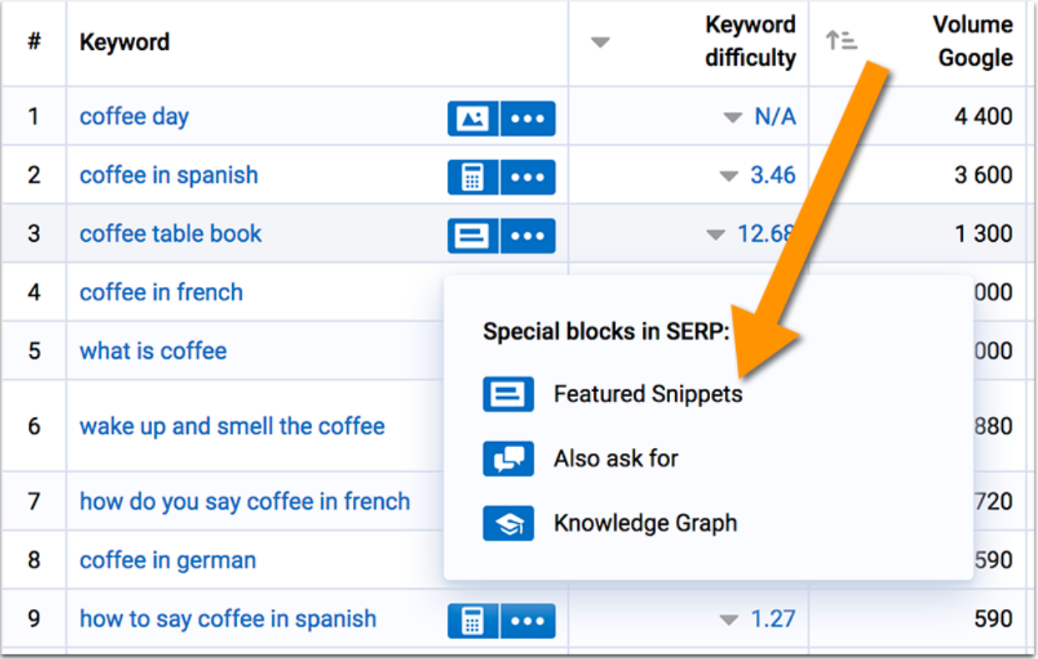
Serpstat.com
@seosmarty

Slide 15
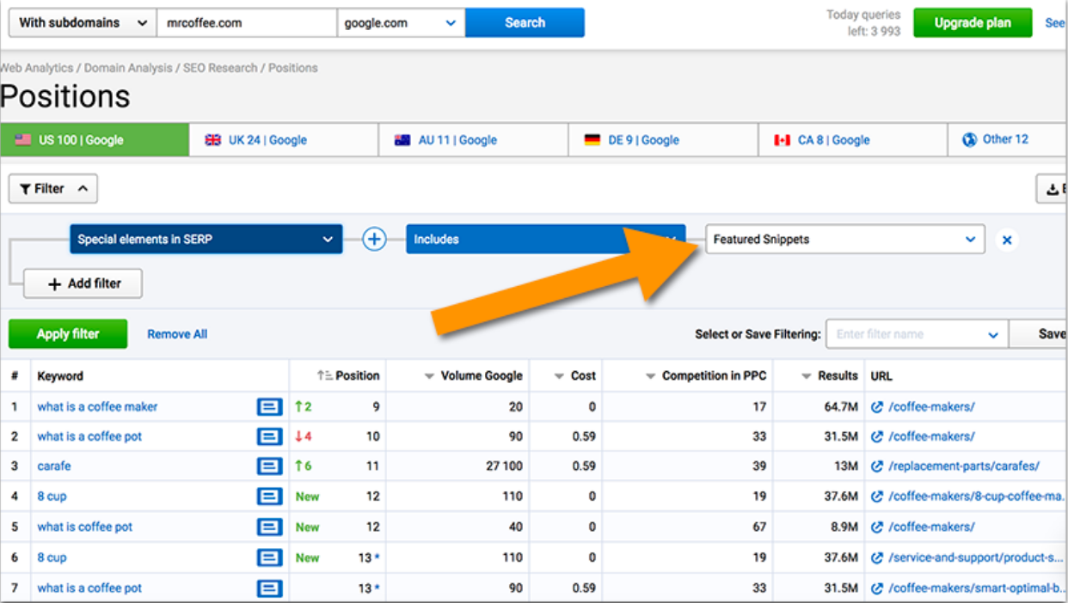
Competitor research with Serpstat
@seosmarty

Slide 16
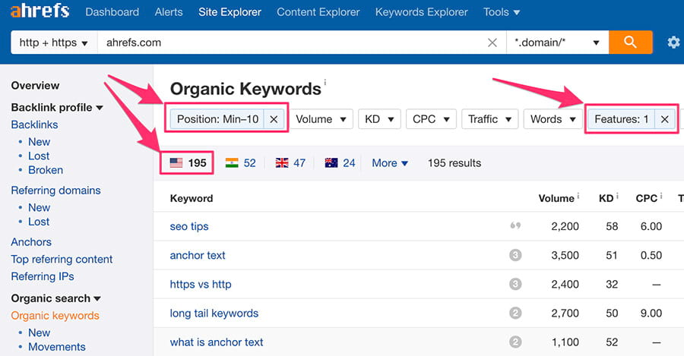
Ahrefs
@seosmarty

Slide 17
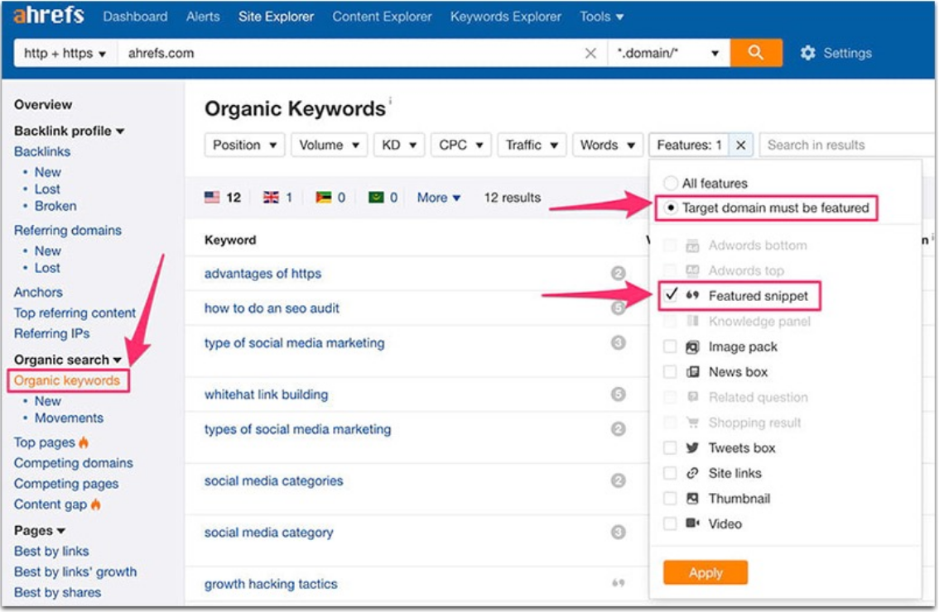
Competitor research with Ahrefs
@seosmarty

Slide 18
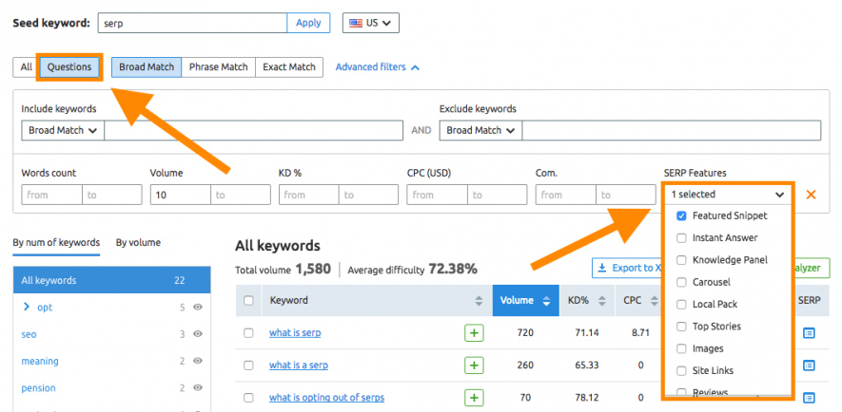
SEMrush
@seosmarty

Slide 19
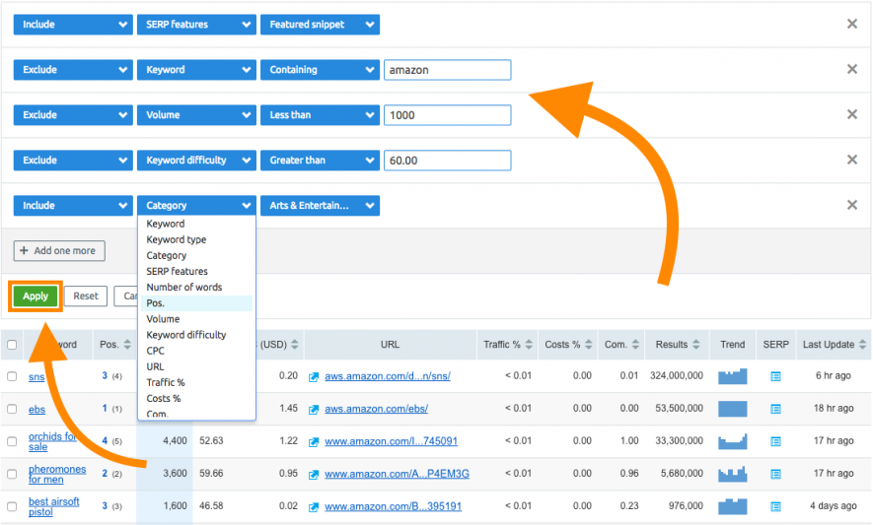
Competitor research with SEMrush
@seosmarty

Slide 20
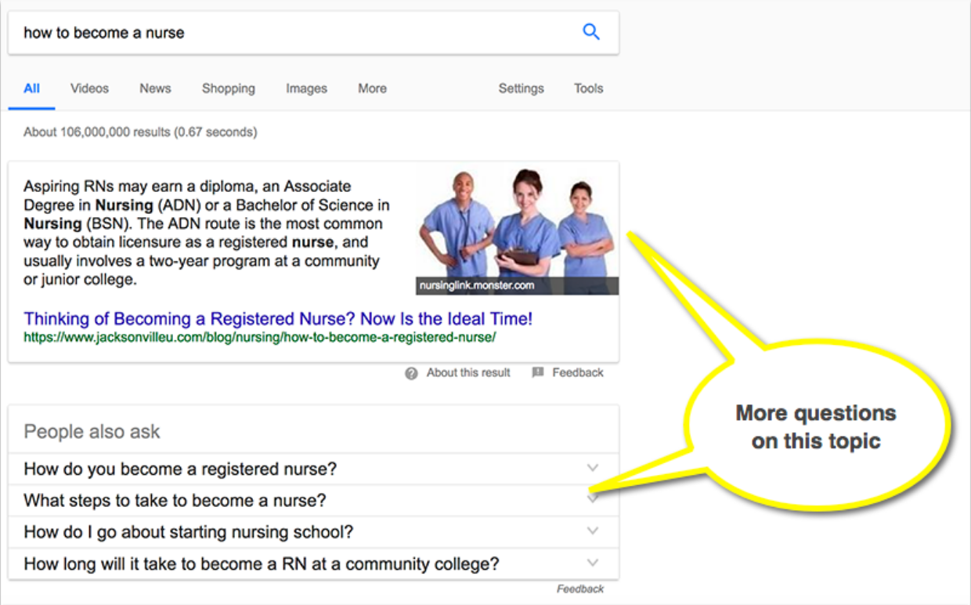
Google “People Also Ask”
@seosmarty

Slide 21
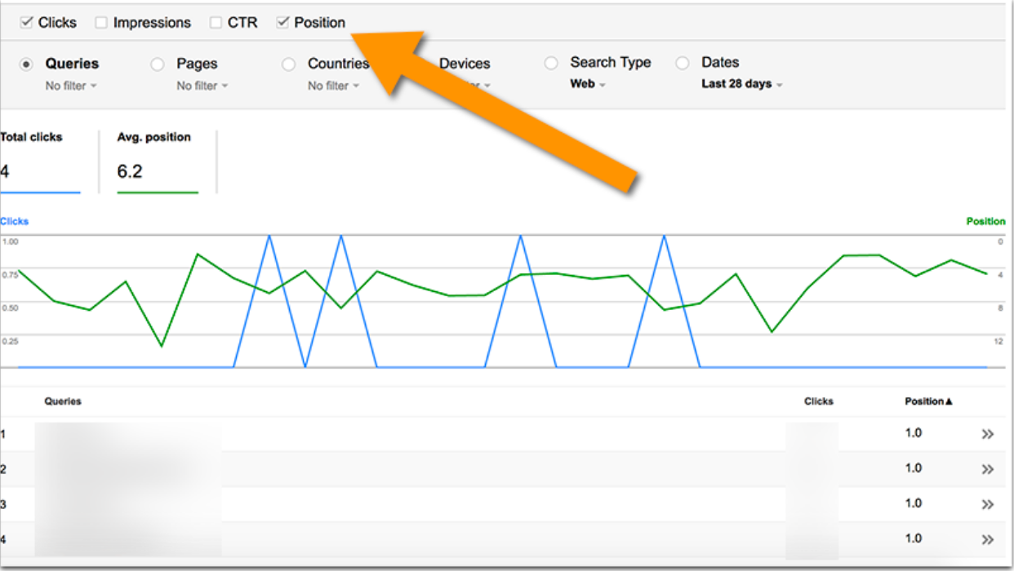
Search Console: "Search Traffic" and then "Search Analytics."
@seosmarty

Slide 22
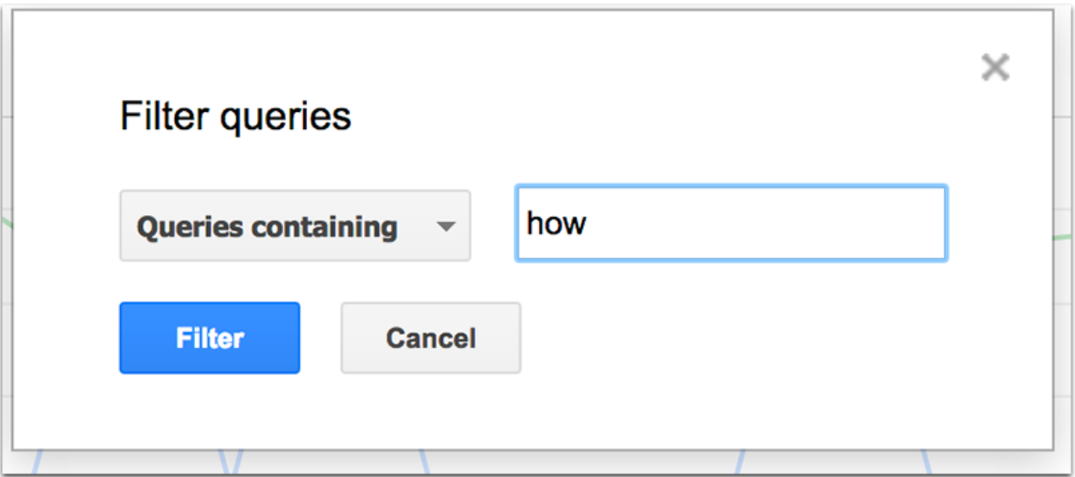
Search Console: "Search Traffic" and then "Search Analytics."
@seosmarty

Slide 23
Go Beyond Traditional Keyword Research Tools: Ask People
@seosmarty

Slide 24
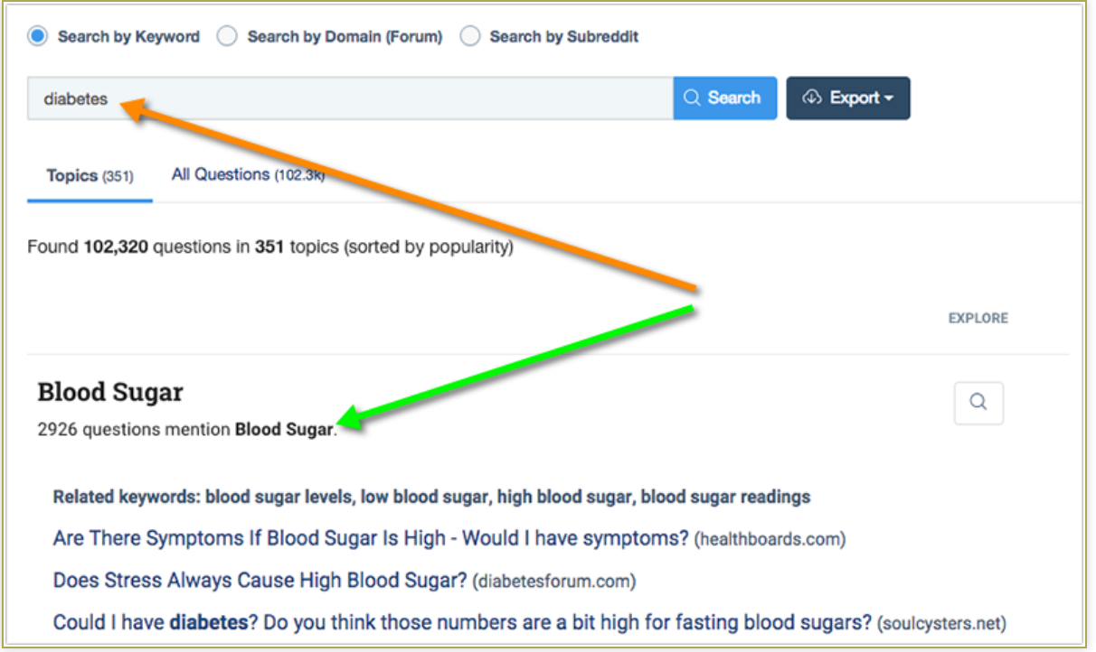
Buzzsumo Question Analyzer
@seosmarty

Slide 25
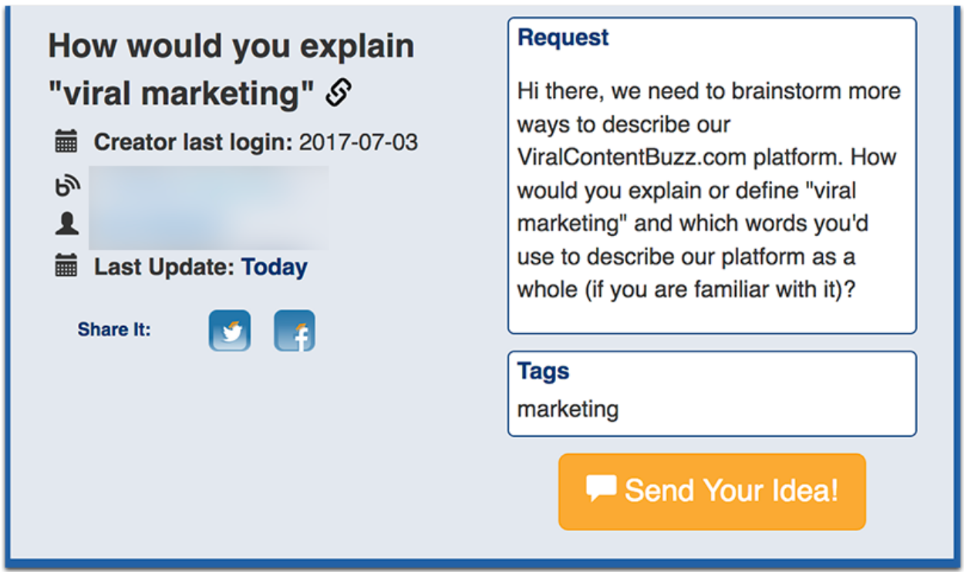
MyBlogU.com
@seosmarty

Slide 26
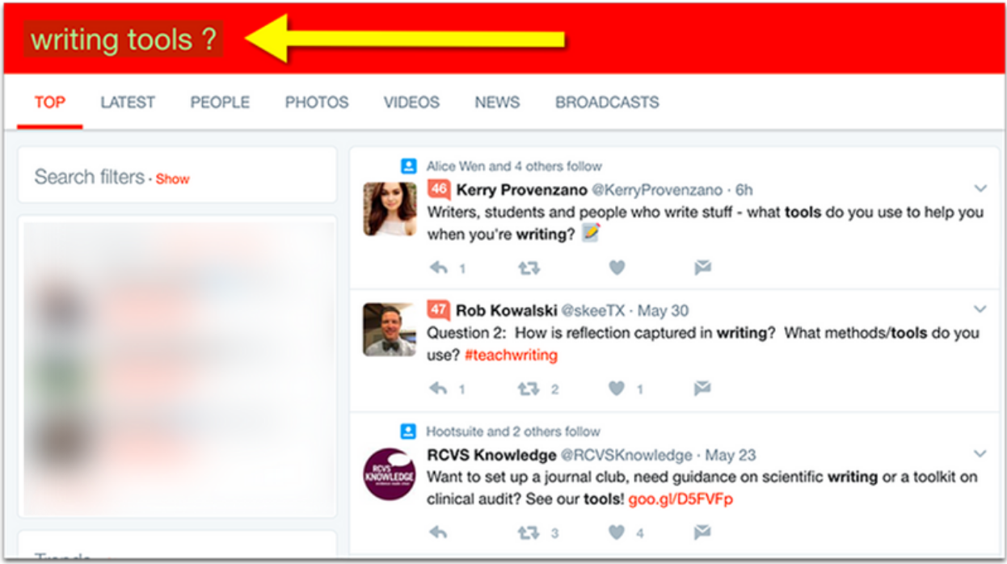
Search and Monitor Twitter [Keyword ?]
@seosmarty

Slide 27
Organize those keywords
@seosmarty

Slide 28
It turns out that a single page can also "be featured" for thousands of search queries…
@seosmarty

Slide 29
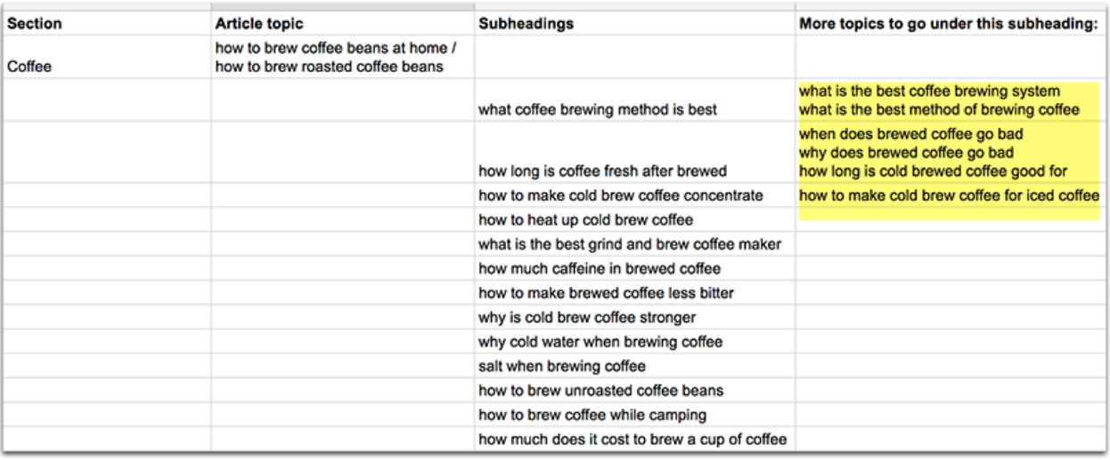
A generic keyword => a section or a category of the blog
A more specific search query => the title of the article
Even more specific queries => the subheadings of the article and thus define its structure
@seosmarty

Slide 30
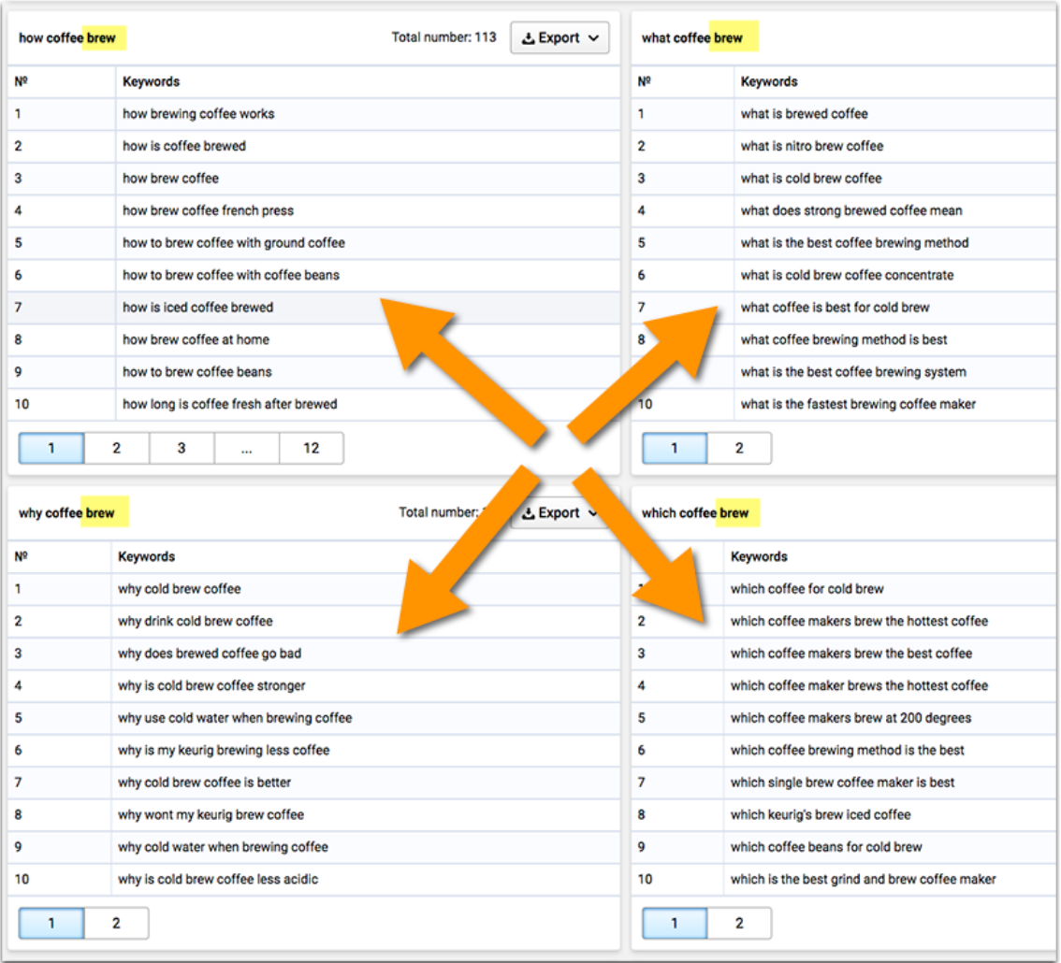
Serpstat “Questions”
@seosmarty

Slide 31
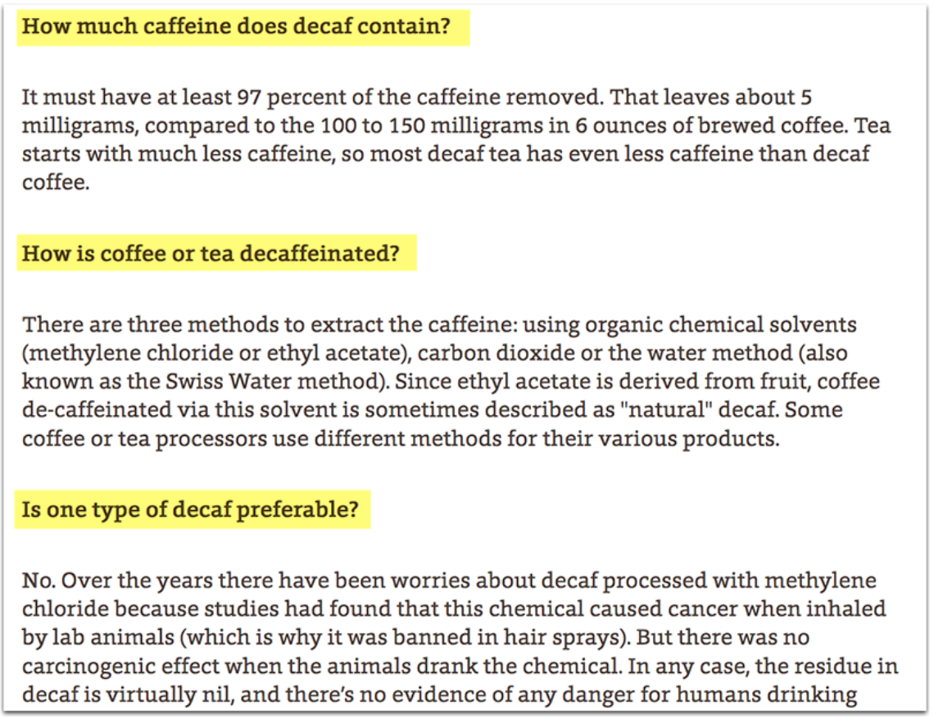
Sample structure
@seosmarty

Slide 32
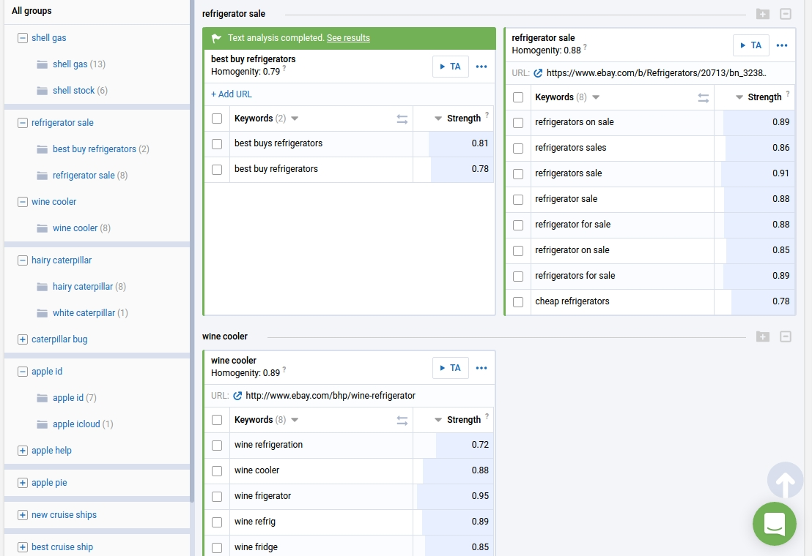
Serpstat “Cluster”
@seosmarty

Slide 33
Answer questions concisely
@seosmarty

Slide 34
The average length of a paragraph snippet is 45 words (the maximum is 97 words)
A.J. Ghergich
@seosmarty

Slide 35
It’s not about the length of the article itself, it’s about answering a specific question concisely
@seosmarty

Slide 36
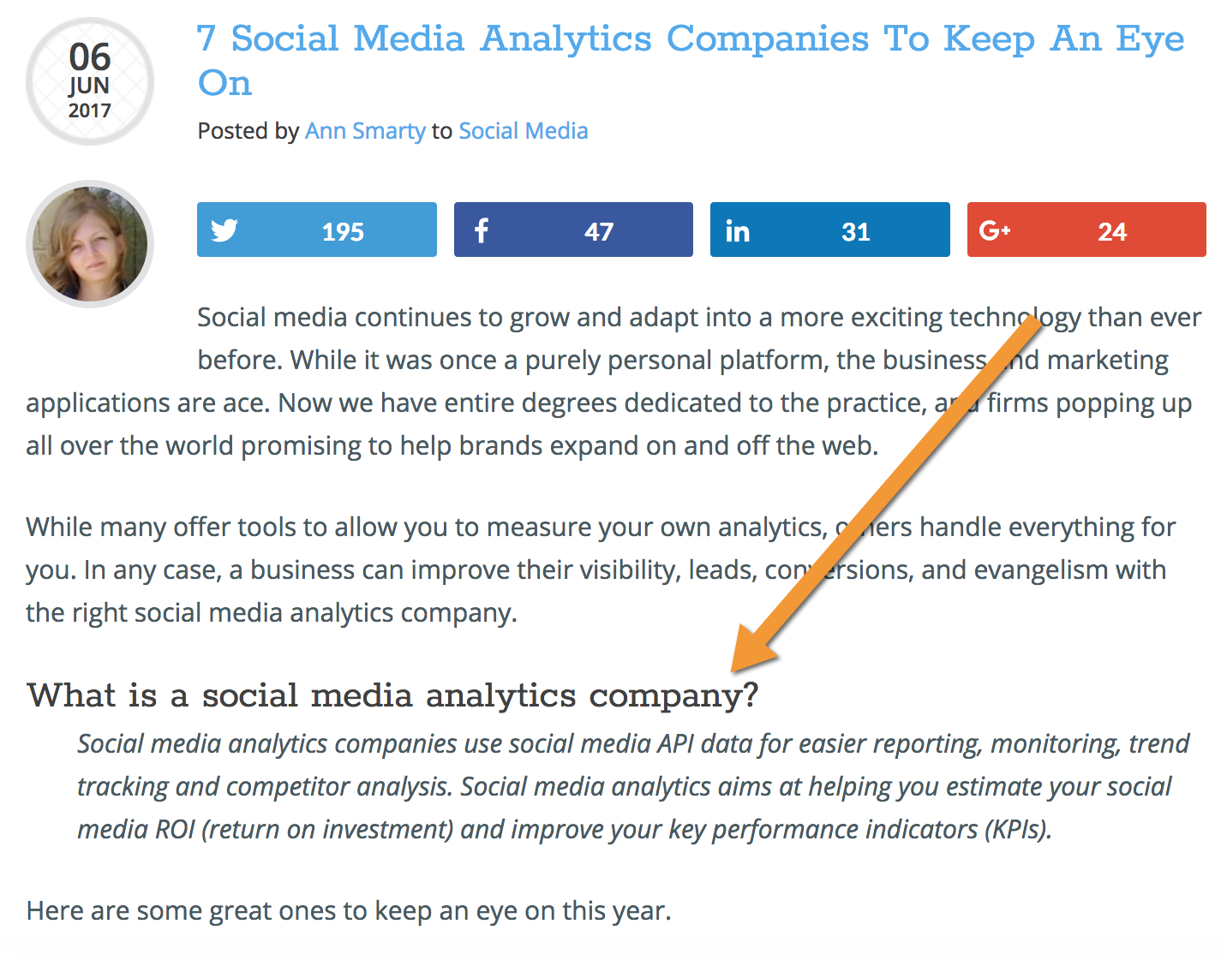
Optimizing for a particular featured box
@seosmarty

Slide 37
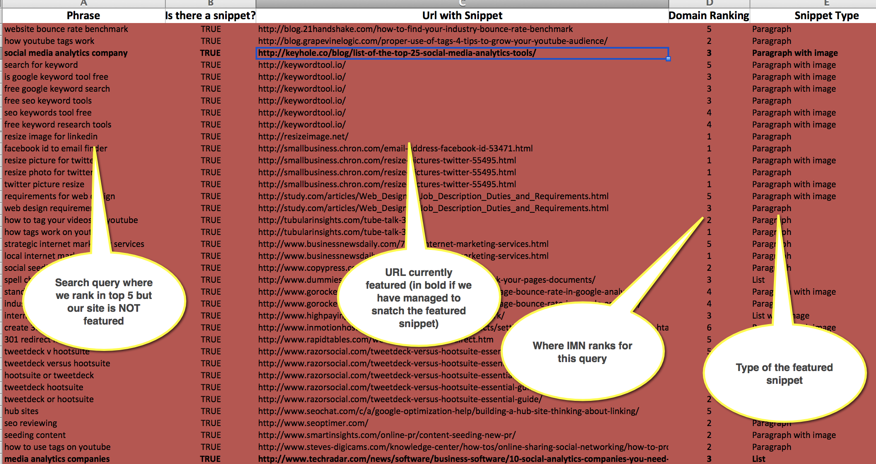
Researching featured opportunities with IMN private tool
@seosmarty

Slide 38
Takeaways
By Ann Smarty
@seosmarty
Brand & Community Manager at
Internet Marketing Ninjas

Slide 39
Being featured in Google search results is your incentive to work harder on your content
You'll discover hundreds of new content ideas (=> diversify your rankings)
You'll learn to research each topic thoroughly (improve your rankings)
You'll learn to structure your articles better (lower bounce rate and improve conversions)
@seosmarty

Slide 40
THANK YOU!
By Ann Smarty
@seosmarty
Brand & Community Manager at
Internet Marketing Ninjas

