Slide 1
TWITTER
HOME PAGE
EVOLUTION

Slide 2
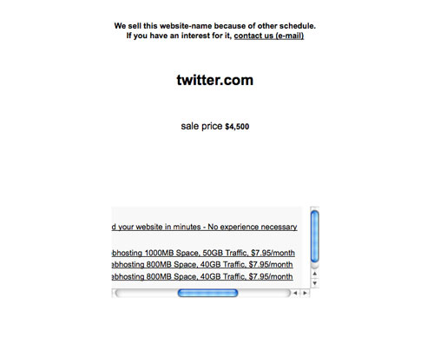
Pre-Twitter (Now we know what the domain name was worth!)

Slide 3
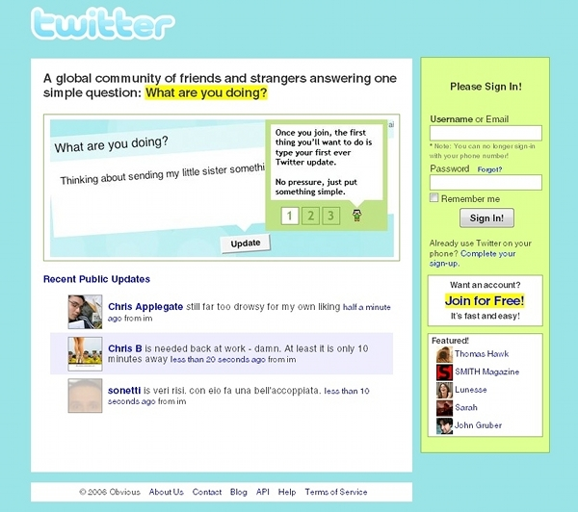
2006 Twitter (Who doesn’t remember that light blue theme!)

Slide 4
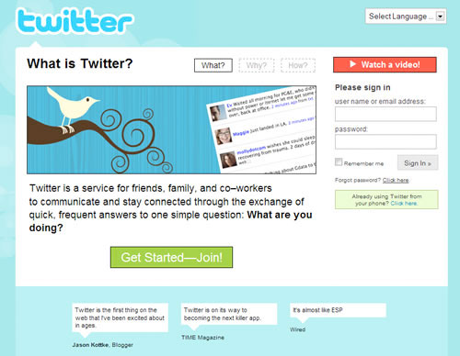
2008 Twitter (Less clutter, still in blue, better calls-to-action)

Slide 5
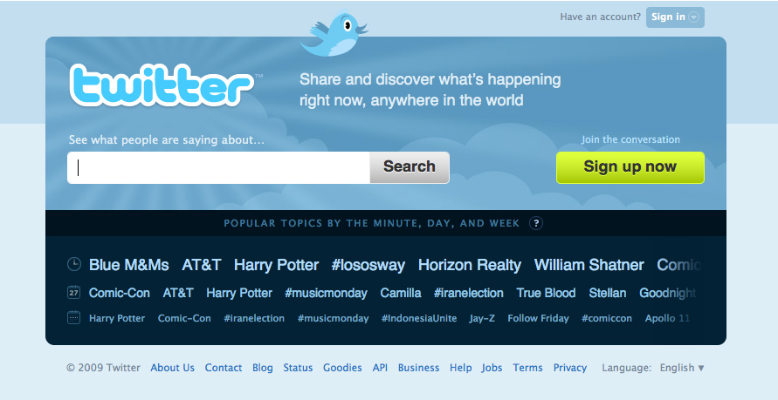
2009 Twitter (Wide-screen-friendlier, featuring hot trends, less blue which makes us sad and nostalgic)

Slide 6
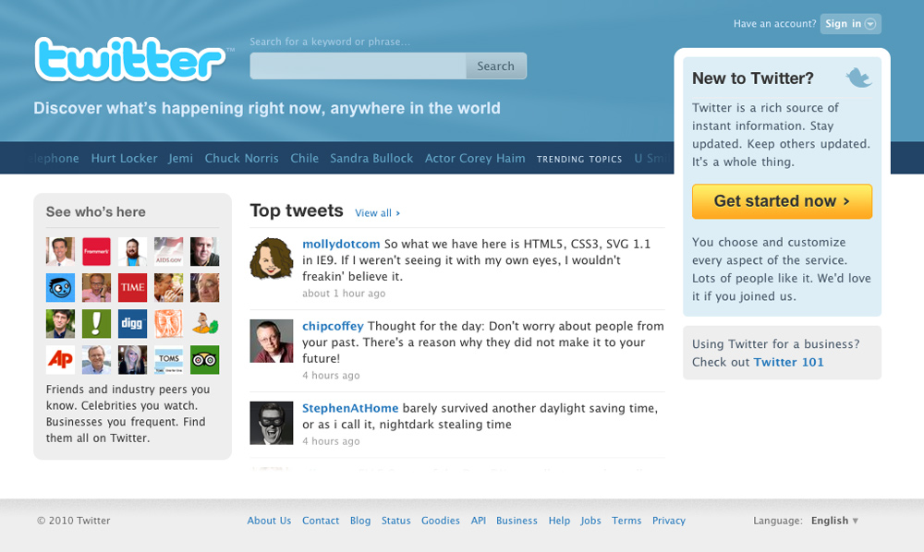
2010 Twitter (More insight into what’s going on inside, even less blue, almost no sign of a bird)

Slide 7
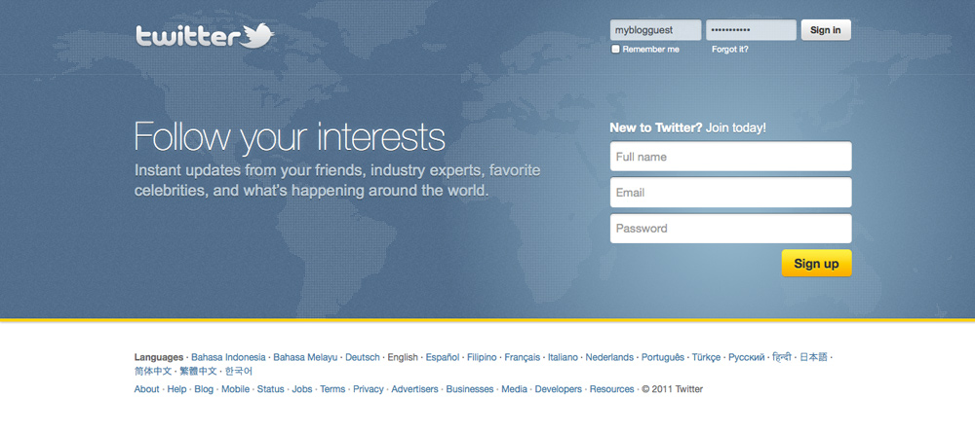
2011 Twitter (Prominent slogan, the ability to register right away (at the same page), almost no blue or bird)

Slide 8
WHAT’S NEXT?
WE’LL SEE!

