Slide 1
LINKEDIN
HOME PAGE
EVOLUTION

Slide 2
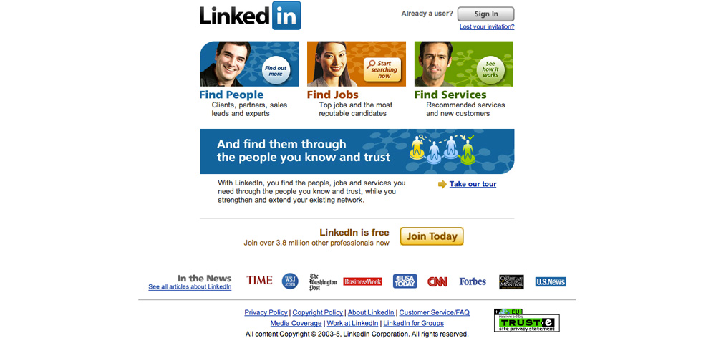
2003: Featuring what is important for a new site: “Trust” certificate, featured mentions, etc

Slide 3
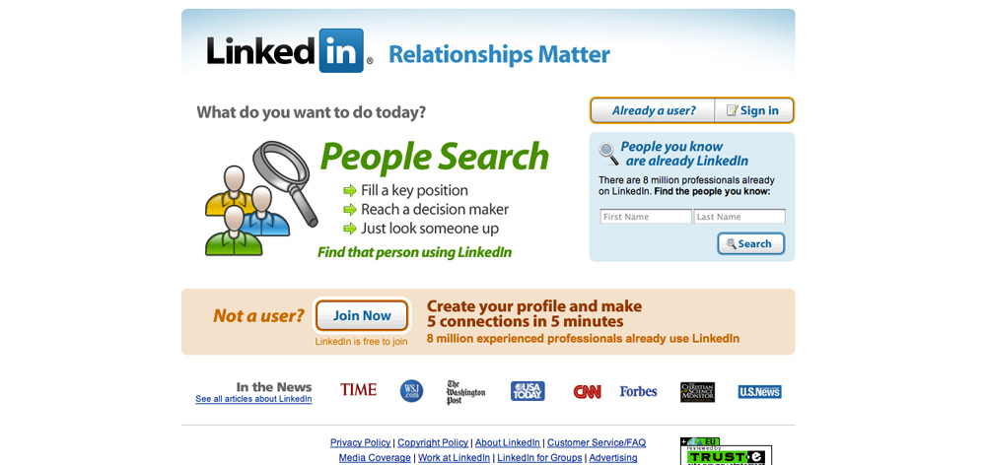
2006: A new catchy slogan (“Relationships Matter”) and a detailed call-to-action (“make 5 connections in 5 minutes”

Slide 4
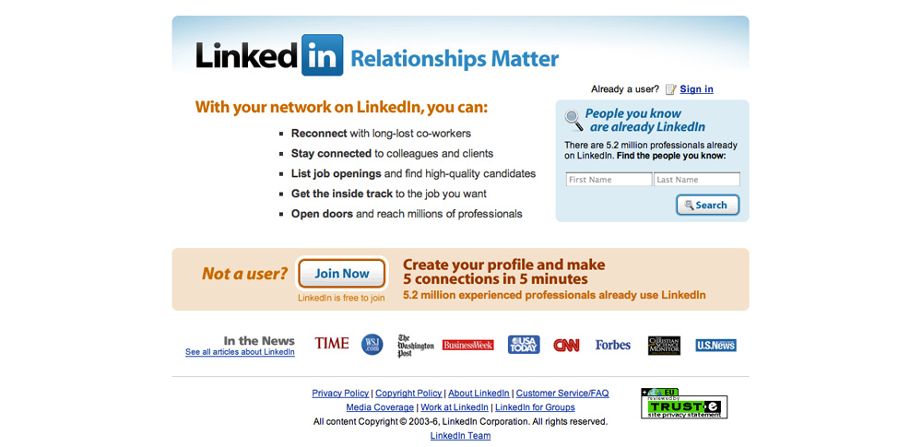
Later in 2006: Better outlining the benefits of joining.

Slide 5
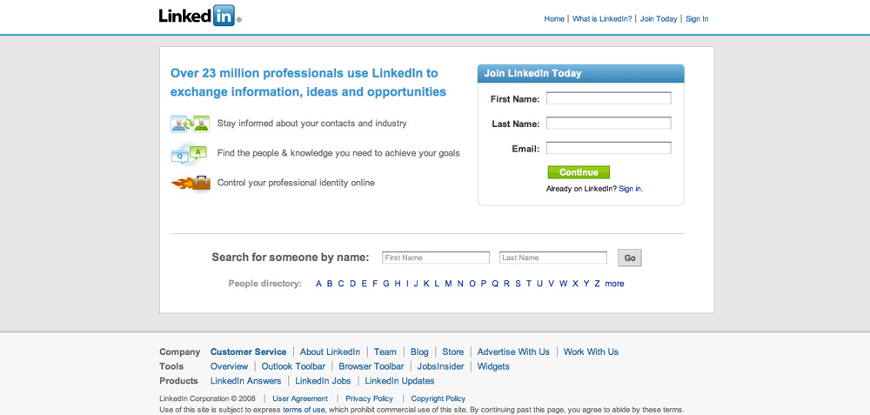
2008: Now you don’t need to click the button to join. You can submit your details right on the home page. Also added: people search and people directory

Slide 6
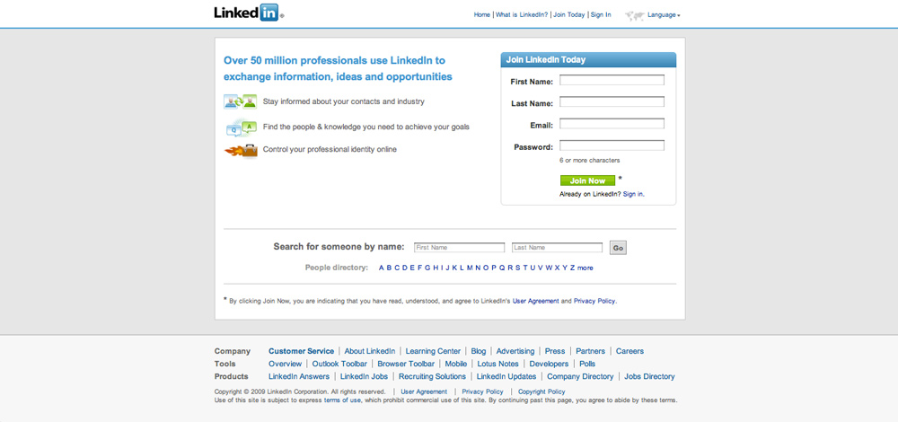
2009: Same design but more people joining!

Slide 7
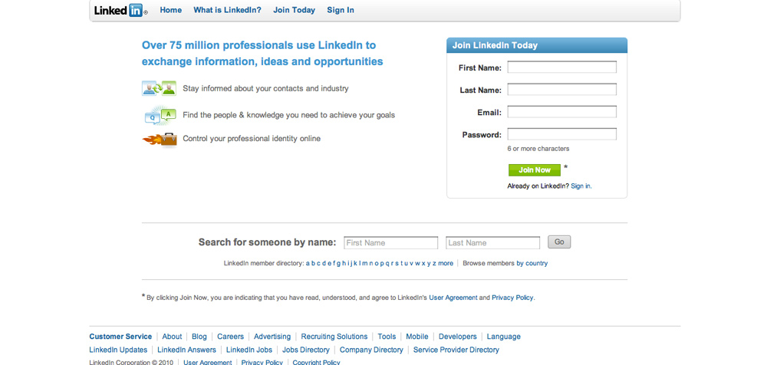
2010: No grey background any more. Now you an not only register but also login right from the home page.

Slide 8
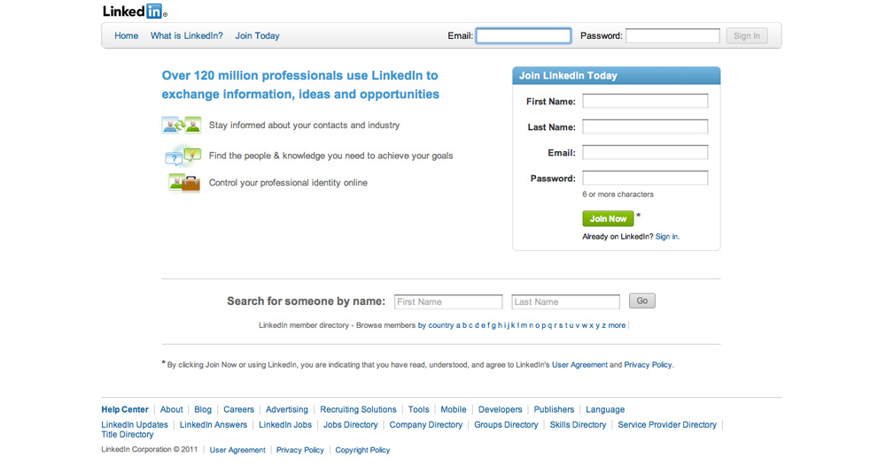
2011: Just a few small tweaks in icons.

Slide 9
WHAT’S NEXT?
WE’LL SEE!

