Slide 1
FACEBOOK
HOME PAGE
EVOLUTION

Slide 2
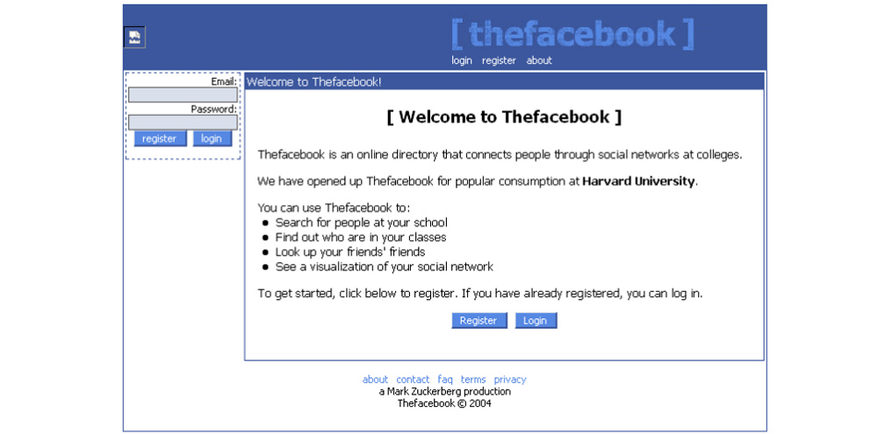
“THEFACEBOOK” 2004 – Harward-only

Slide 3
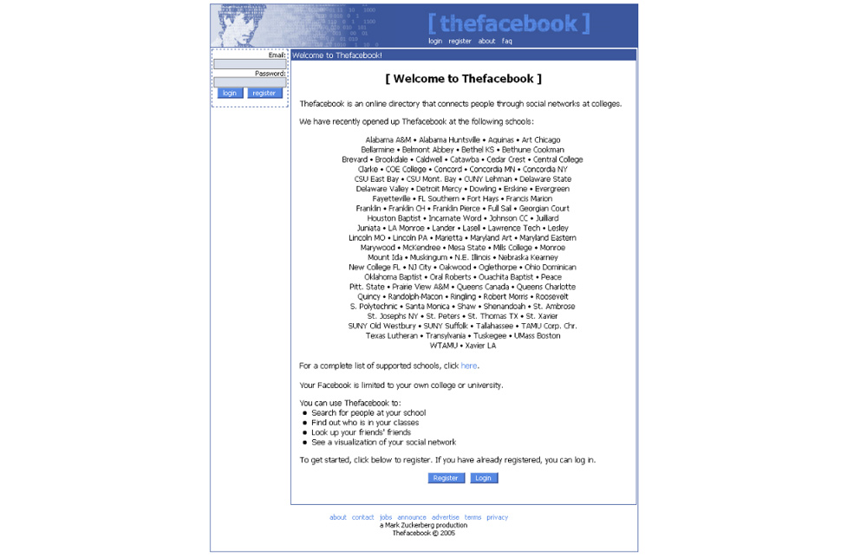
“THEFACEBOOK” 2005 – Quickly expanding

Slide 4
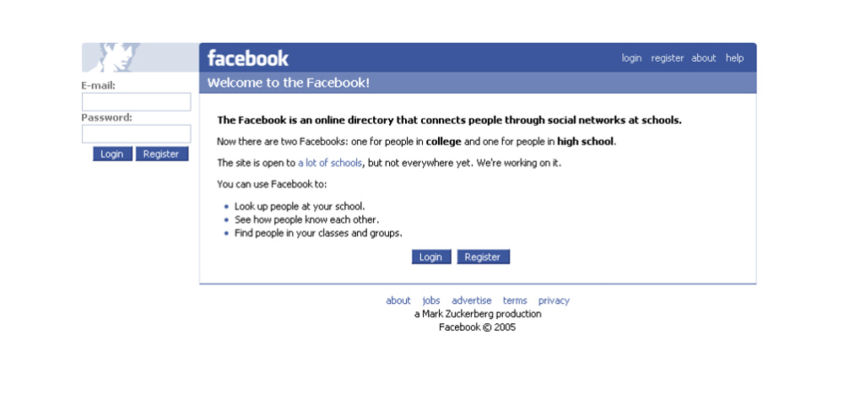
“THE FACEBOOK” 2005 – No way to list all participating institutions now. Now the site is open to “a lot of schools”. The spelling is also different: “the Facebook” (as two words)

Slide 5
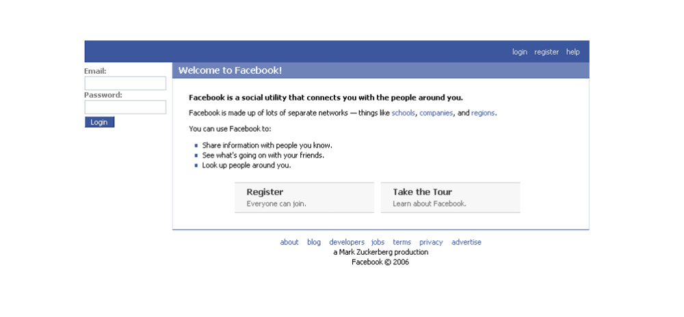
“FACEBOOK” 2006 – No more THE at last! It’s no longer “school”-specific as you can connect with fellow company workers and country residents now! No weird blue man icon as well.

Slide 6
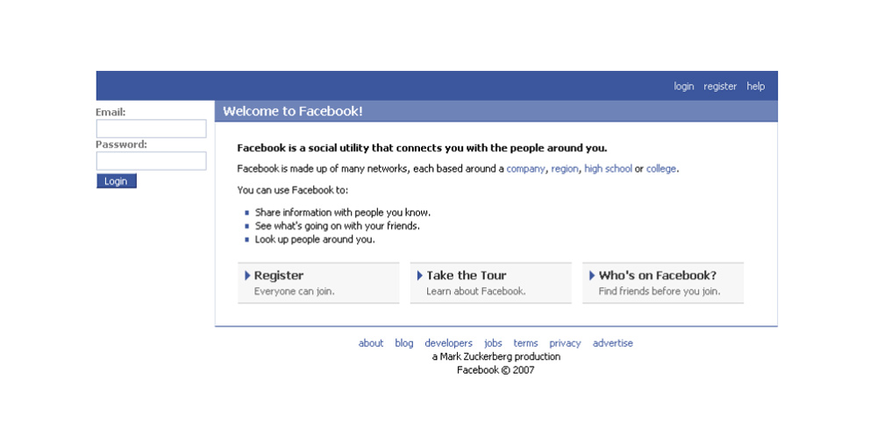
Almost the same interface but more options (Register – Take a Tour – Who’s on Facebook)

Slide 7
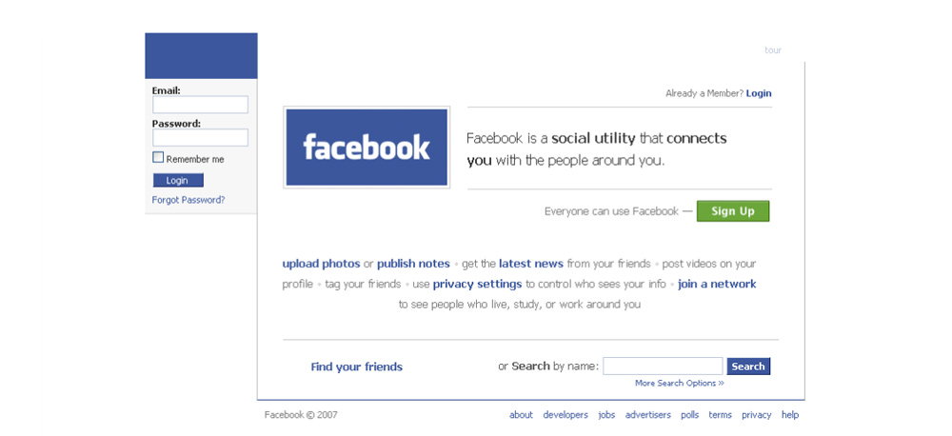
Facebook 2007: Finally, the dark-blue color we love! The inside world and options are better explained. The home page starts featuring the search option as well.

Slide 8
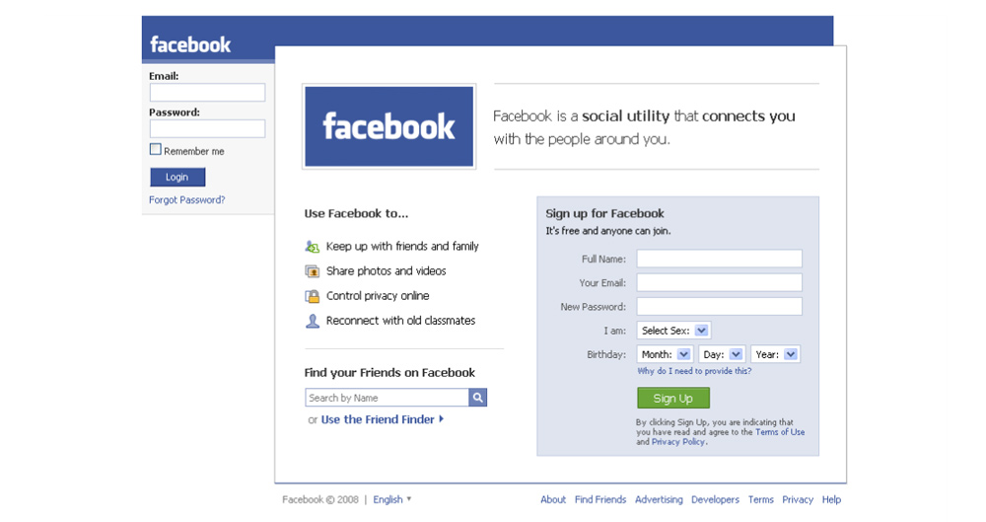
Facebook 2008: The home page is almost appealing! The sign-up option is added right on the home page.

Slide 9
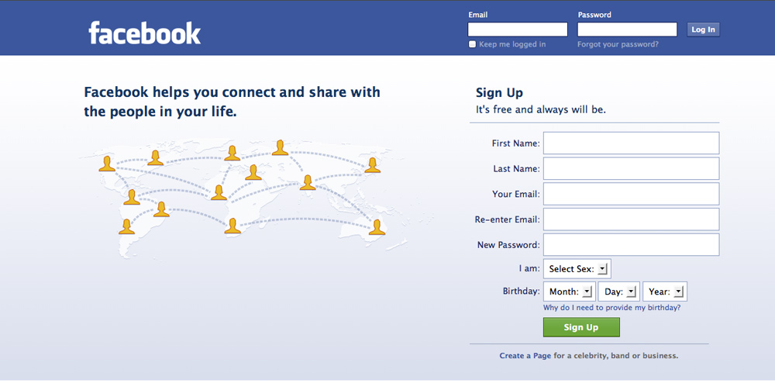
Facebook 2010-2011: The home page features an infographic. The search option is gone. The option to create a PAGE to advertise a celebrity, band or business is promoted right on the home page.

Slide 10
WHAT’S NEXT?
WE’LL SEE!

